Slide 1
EE5323 Homework #1: Ring Oscillator Design
Kartheshwar shanmuga sundaram
5569005

Slide 2
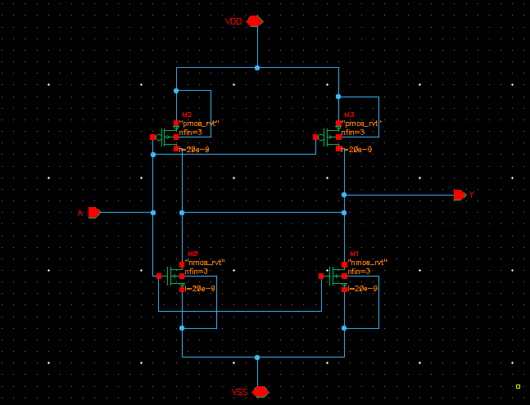
1.Schematic for inverter INVx2_ASAP7_75t_SL standard cell in virtuoso

Slide 3
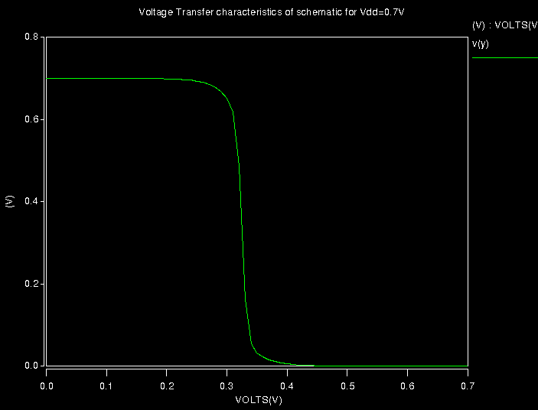
Voltage Transfer characteristics of schematic- inverter INVx2_ASAP7_75t_SL

Slide 4
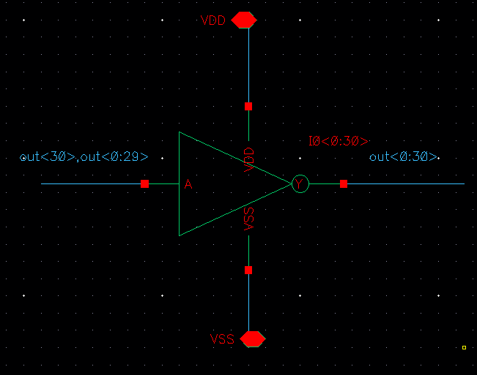
2. Schematic of 31 stage ring oscillator using bus notation

Slide 5
3. Ring Oscillator Frequency for different PVT for the netlist generated using schematic
Temperature (degree Celsius) | Vdd (Volts) | RVT frequency (GHz) | LVT frequency (GHz) | SLVT Frequency (GHz)
0 | 0.63 | 5.0429 | 6.4652 | 7.6654
 | 0.7 | 5.9086 | 7.1996 | 8.214
 | 0.77 | 6.6202 | 7.7647 | 8.6008
25 | 0.63 | 4.9456 | 6.3243 | 7.4775
 | 0.7 | 5.7684 | 7.0233 | 8.0011
 | 0.77 | 6.4504 | 7.5664 | 8.3775
110 | 0.63 | 4.7337 | 5.967 | 6.9576
 | 0.7 | 5.4238 | 6.5549 | 7.7405
 | 0.77 | 6.0085 | 7.0299 | 7.7436

Slide 6
Analysis
When temperature increases charge carrier mobility and transistor threshold decreases. The effect of threshold voltage is less and mobility is the more dominant effect. So when temperature increases mobility decreases and cell delay increases which means frequency is reduced. This is as per the trend seen in the table in the previous page
According to alpha power well law model, current is inversely proportional to Vt . Current is inversely proportional to time (I=C dV/dt). Cell delay decreases with decrease of threshold voltage, so the frequency increases with decreases of threshold voltage. So maximum frequency is observed in SLVT where Vt is least, followed by LVT and RVT.
According to alpha power well law model, current is directly proportional to Vdd . Current is inversely proportional to time (I=C dV/dt). So Vdd is inversely proportional to time. Therefore as Vdd increases the frequency increases as seen in the table in the previous page.

Slide 7
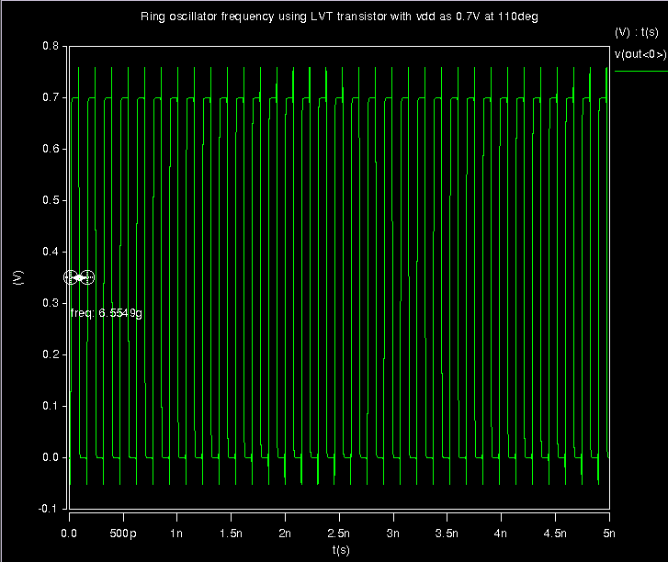
Example of Ring oscillator schematic frequency using LVT transistor with Vdd=0.7V at 110 degree

Slide 8
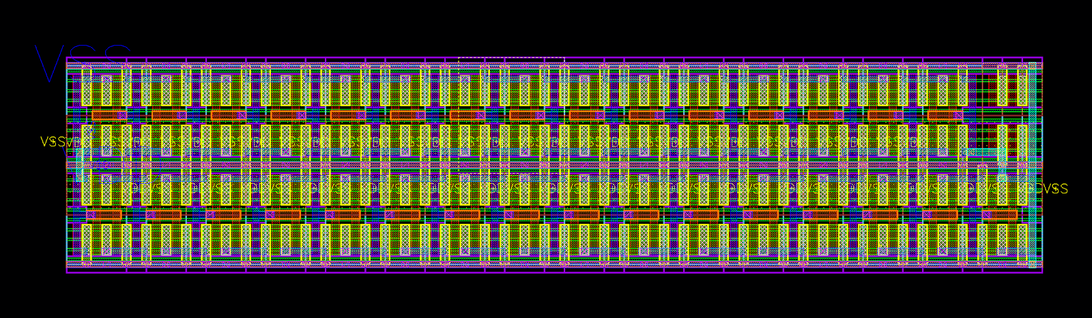
Layout of 31 stage ring oscillator using INVx2_ASAP7_75t_SL layout (RVT)

Slide 9
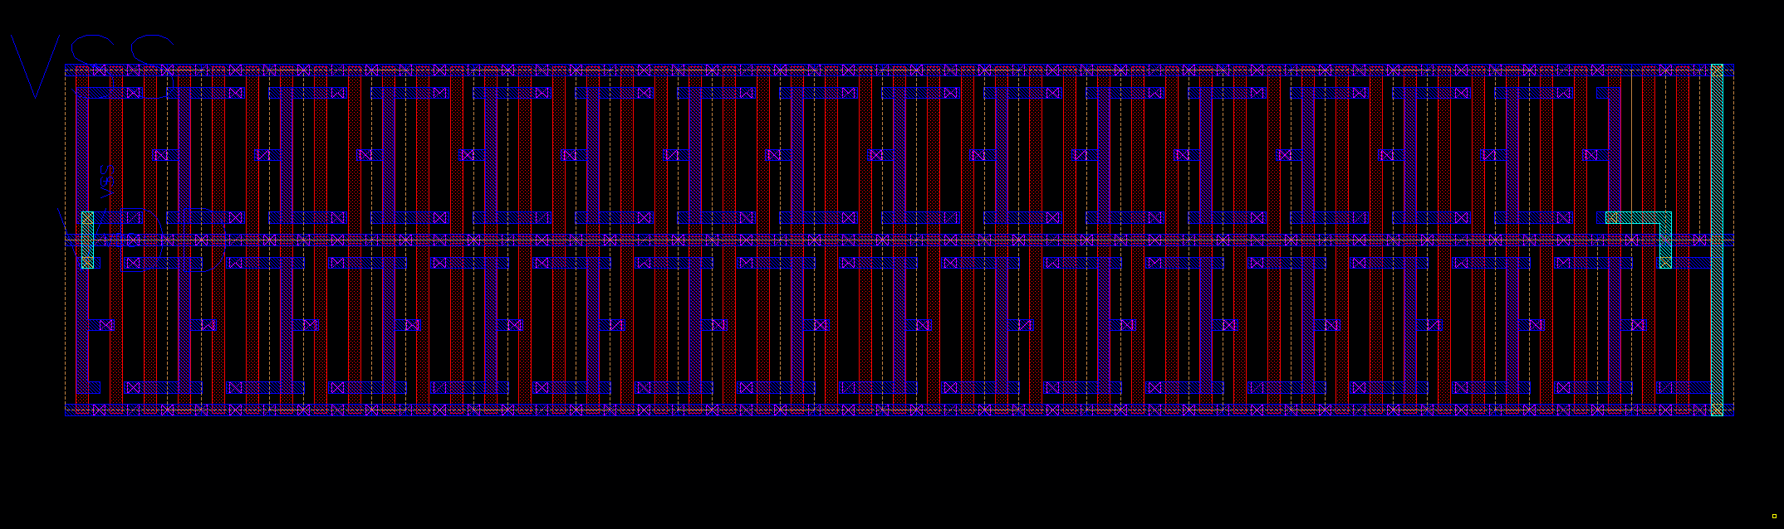
Layout-- showing just metal layer to indicate connections

Slide 10
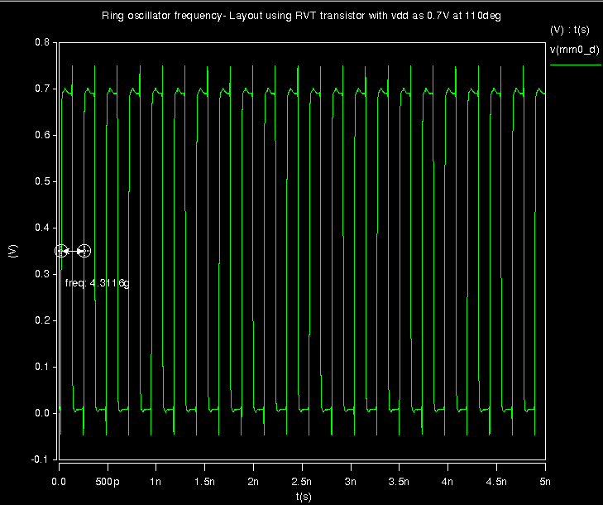

Frequency of layout (RVT) at 110 degrees with 0.7V

Slide 11
Calculation and analysis
Percentage difference in frequency between schematic and extracted layout at 0.7v & 110 degree C
= (1 - (frequency of layout/frequency of schematic))
= (1-(4.3116/5.4238) ) *100 =20.505%
The metal used for interconnect causes the capacitance of the layout to be increased (parasitic capacitance) which proportionally decreases the frequency (time delay is proportional to Capacitance) .
In layout the overall capacitance is C_{total}= C_{dbp} + C_{dbn} + C_{wire} + C_{gsp} + C_{gsn}+ C_{miller}
These effect doesn’t get reflected in the schematic so the frequncy of schematic is more compared to layout
To match the frequency of the schematic with the layout an extra capacitor is added as a part of netlist of schematic
The capacitance sweep is done in netlist and the frequency vs capacitance plot will help to determine the exact value of capacitor needed to be within 1% of each other
As it can be seen from the next page the capacitance value which needs to be added at the schematic is 225.21a

Slide 12
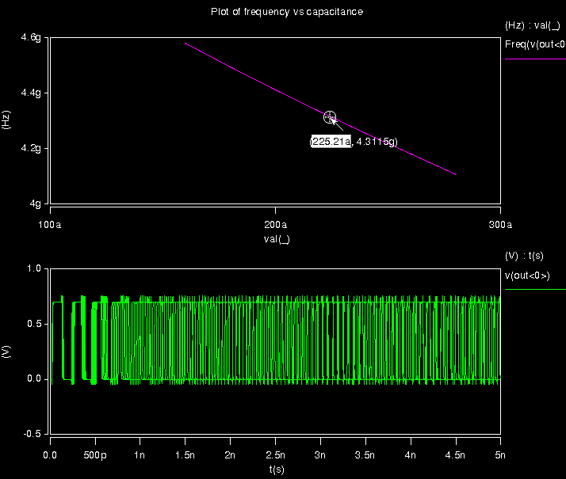
capacitance value found by sweeping the capacitor

Slide 13
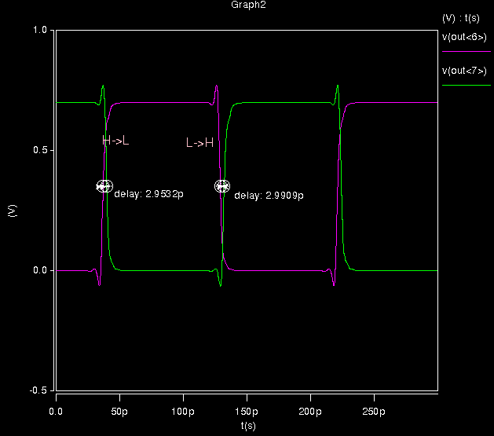
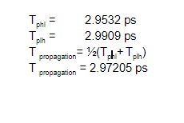
The propagation delay for ring oscillator- Schematic

Slide 14
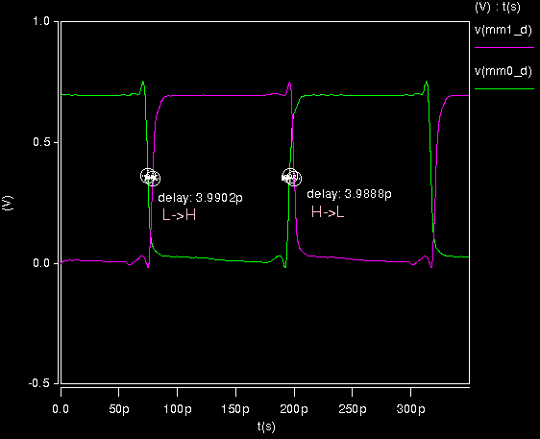
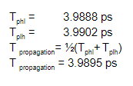
The propagation delay for ring oscillator- layout

